Slide 1

Tracking Air Pollution with Sentinel-5P Imagery: NO₂ Monitoring in Google Earth Engine
By:HAFSA FATHIMA
ROLL NO:24011D6014
BRANCH : ENVIRONMENTAL GEOMATICS

Slide 2
1. Introduction
Air pollution is one of the leading environmental risks to human health and ecosystems worldwide. Among the most harmful pollutants is nitrogen dioxide (NO₂), primarily emitted by vehicles, power plants, and industrial activities. Monitoring NO₂ is crucial for understanding air quality trends, identifying pollution sources, and informing policy.
This project aims to utilize Sentinel-5P satellite imagery in Google Earth Engine (GEE) to monitor and analyze NO₂ concentrations over selected urban areas. Sentinel-5P, operated by the European Space Agency (ESA), provides high-resolution atmospheric composition data, enabling near-real-time air pollution assessment on a global scale.

Slide 3
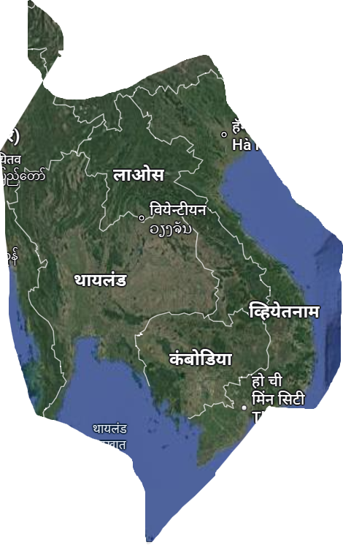
STUDY AREA
COORDINATES:
96.6395313899994, 21.0445132335095],
[96.6395313899994, 5.2233370180906595],
[111.9764454524994, 5.2233370180906595],
[111.9764454524994, 21.0445132335095

Slide 4
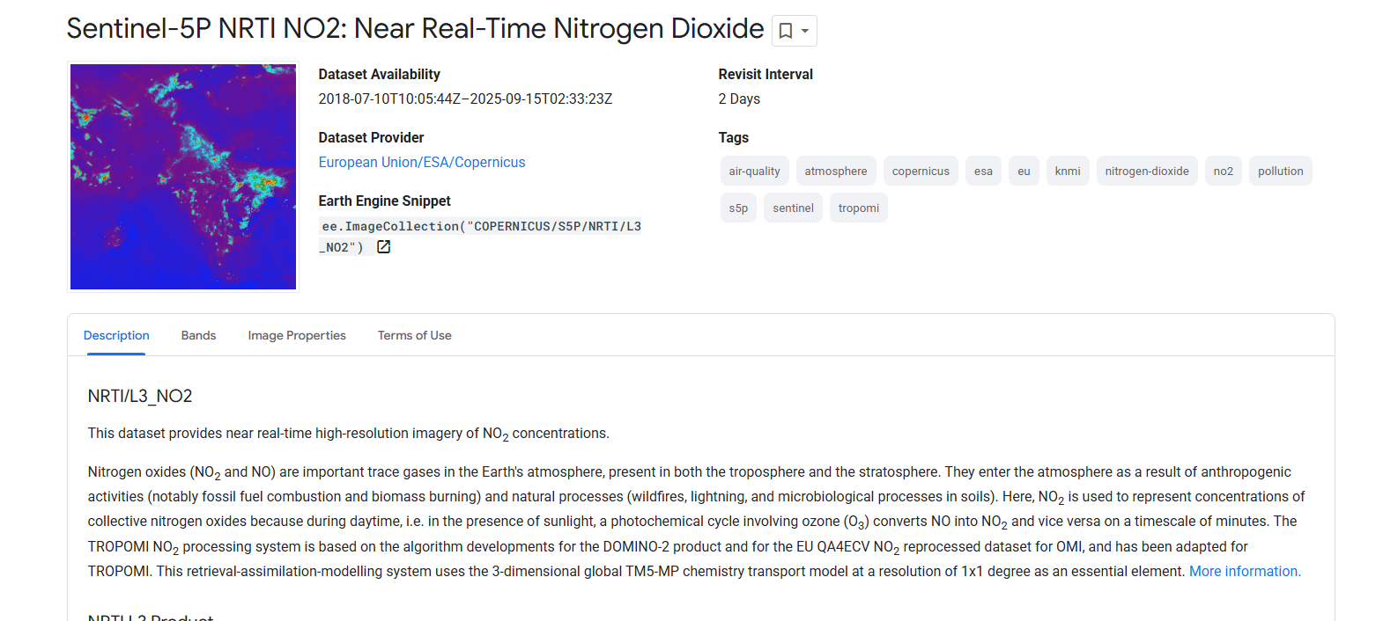
DATASET:SENTINEL 5P

Slide 5
tropomi
This dataset provides near real-time high-resolution imagery of NO₂ concentrations.
Nitrogen oxides (NO₂ and NO) are important trace gases in the Earth's atmosphere, present in both the troposphere and the stratosphere. They enter the atmosphere as a result of anthropogenic activities (notably fossil fuel combustion and biomass burning) and natural processes (wildfires, lightning, and microbiological processes in soils). Here, NO₂ is used to represent concentrations of collective nitrogen oxides because during daytime, i.e. in the presence of sunlight, a photochemical cycle involving ozone (O₃) converts NO into NO₂ and vice versa on a timescale of minutes. The TROPOMI NO₂ processing system is based on the algorithm developments for the DOMINO-2 product and for the EU QA4ECV NO₂ reprocessed dataset for OMI, and has been adapted for TROPOMI

Slide 6
2. Objectives
To acquire and visualize NO₂ concentration data from Sentinel-5P.
To track spatial and temporal variations in NO₂ across selected regions.
To identify pollution hotspots and seasonal patterns.
To demonstrate the effectiveness of Google Earth Engine for large-scale environmental monitoring.

Slide 7
3. Tools and Data Used
3.1 Sentinel-5P (TROPOMI) Data
Product: COPERNICUS/S5P/NRTI/L3_NO2
Variable: NO2_column_number_density
Resolution: ~7 x 3.5 km
Temporal Coverage: Daily from 2018 onwards
3.2 Google Earth Engine
A cloud-based platform for planetary-scale geospatial analysis. Key features include:
Access to satellite data catalogs
JavaScript and Python APIs
Built-in data visualization and analysis tools

Slide 8
4. Methodology
Selection of Area of Interest (AOI): Example cities: Delhi (India), Beijing (China), and Los Angeles (USA).
Time Period: NO₂ data analyzed for a full year (e.g., January 2023 to December 2023) to observe seasonal changes.
Data Processing Steps in GEE:
Import Sentinel-5P NO₂ dataset
Filter by date and AOI
Apply cloud masking if needed
Compute daily, monthly, and seasonal averages
Visualize using custom color palettes
Export statistics and images
Sample GEE Code Snippet:
var city = ee.Geometry.Point([77.1025, 28.7041]); // Delhi var no2 = ee.ImageCollection('COPERNICUS/S5P/NRTI/L3_NO2') .select('NO2_column_number_density') .filterBounds(city) .filterDate('2023-01-01', '2023-12-31') .mean(); var visParams = { min: 0.00002, max: 0.0005, palette: ['blue', 'green', 'yellow', 'orange', 'red'] }; Map.centerObject(city, 8); Map.addLayer(no2.clip(city.buffer(50000)), visParams, 'Annual Mean NO₂ - 2023');

Slide 9
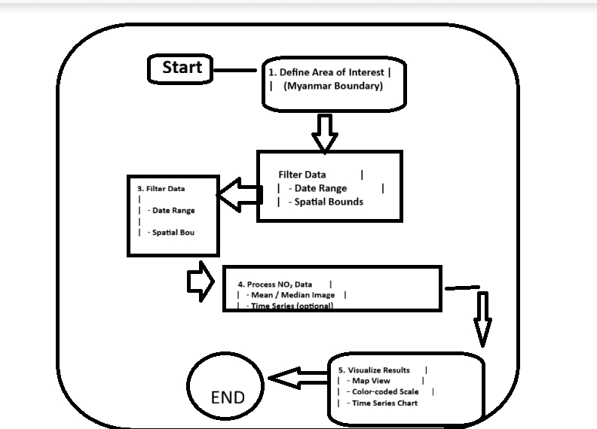
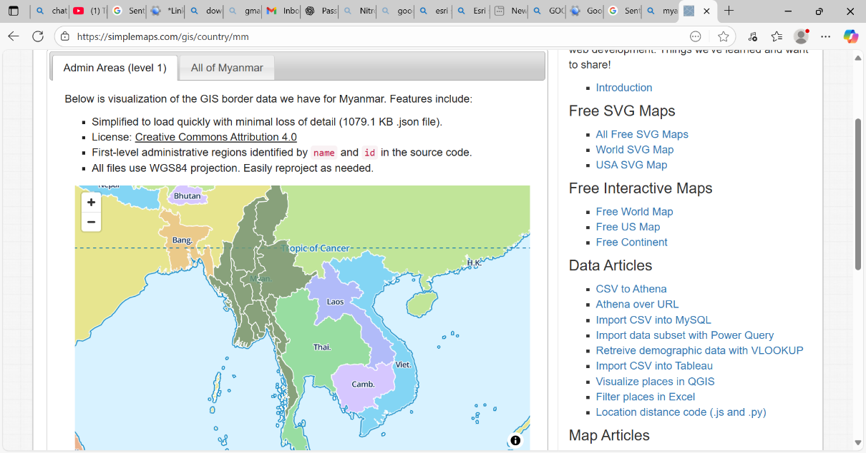
Flowchart

Slide 10
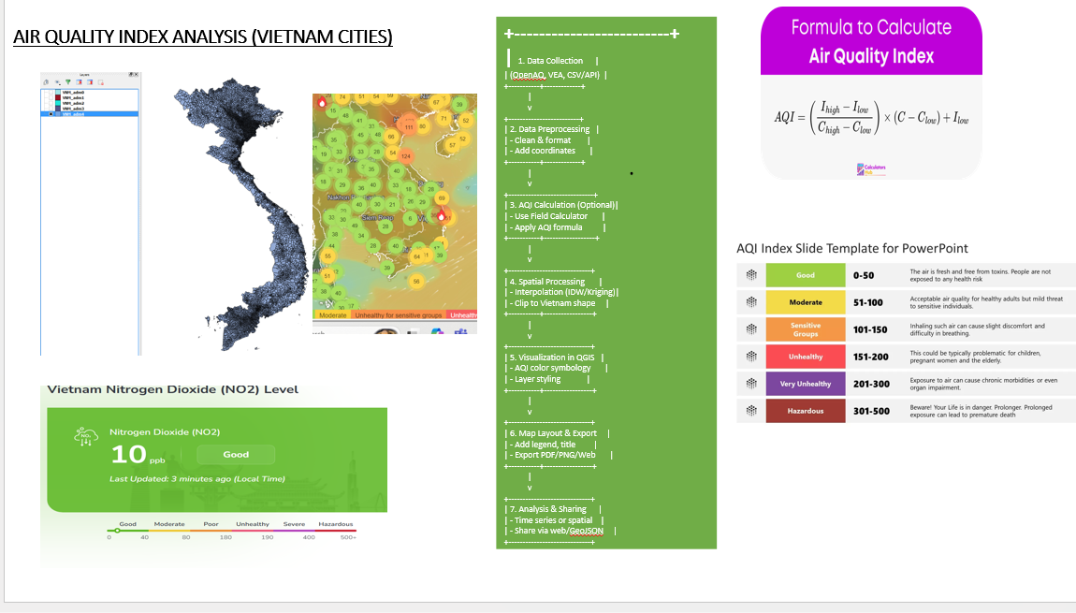
AQI ESTIMATION SOFTWARES

Slide 11
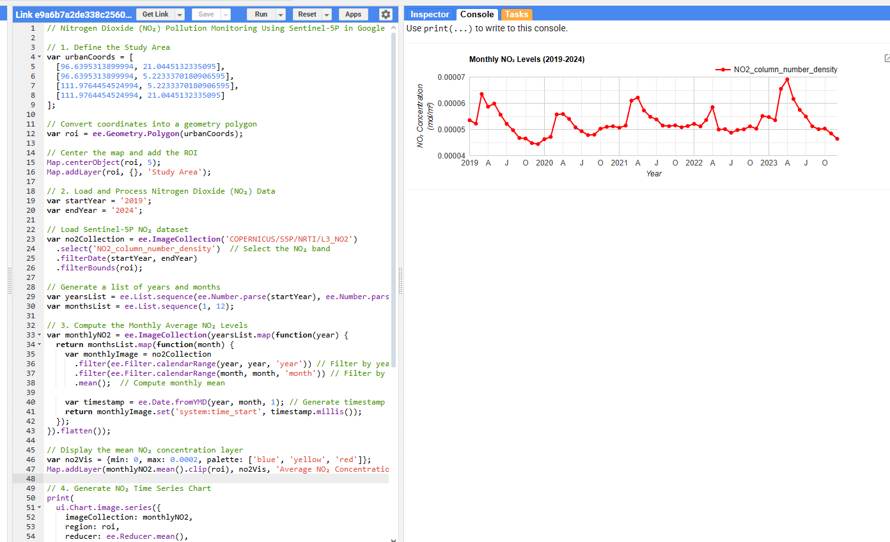
DATA ANALYSIS

Slide 12
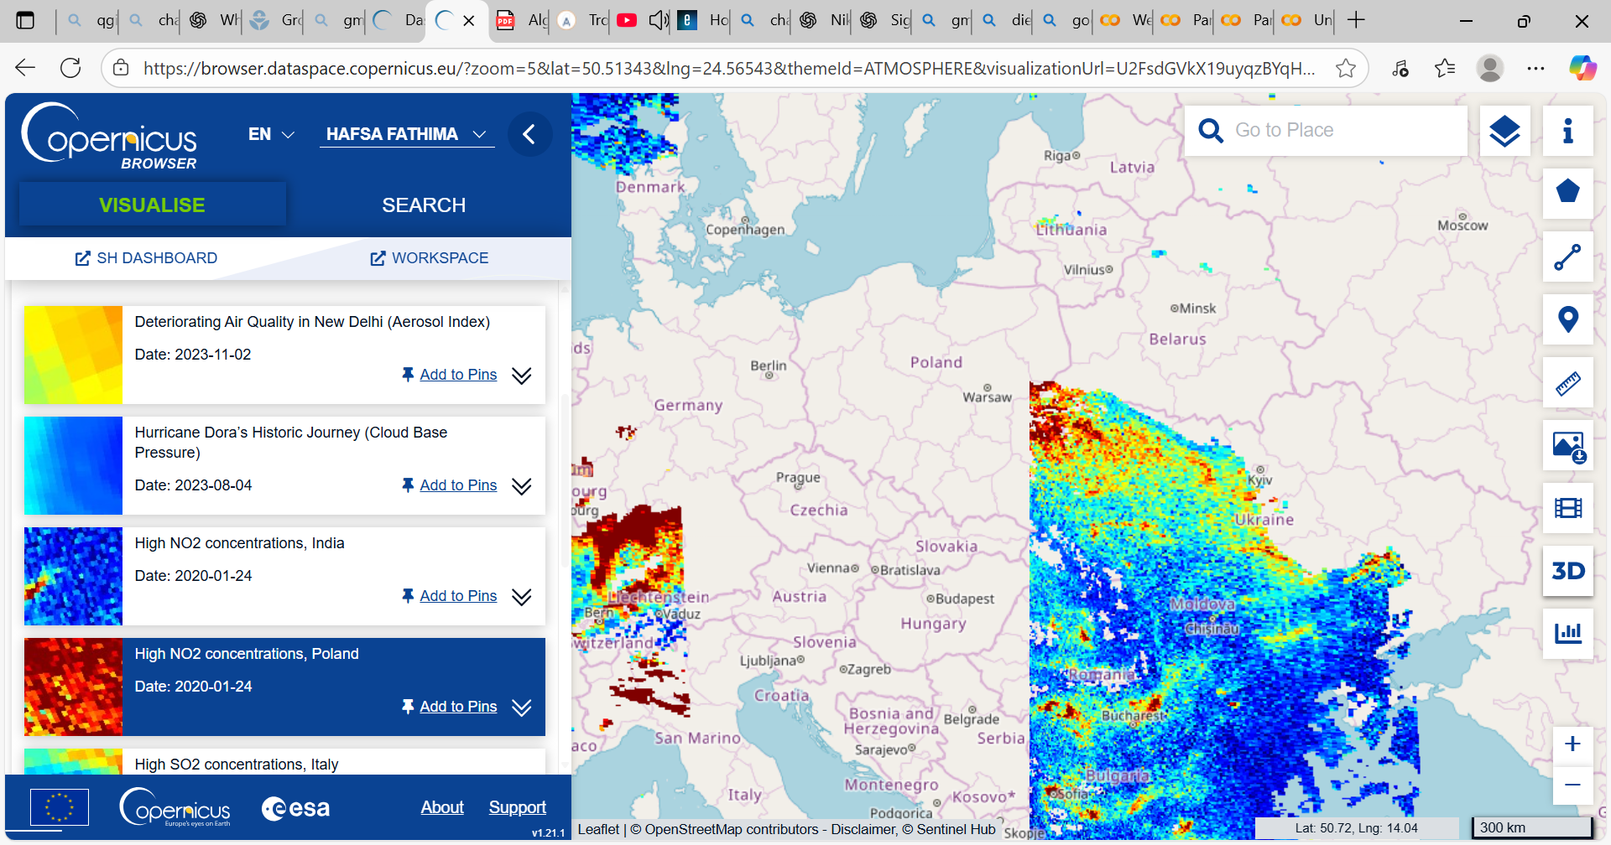
SCREEN SHOTS

Slide 13
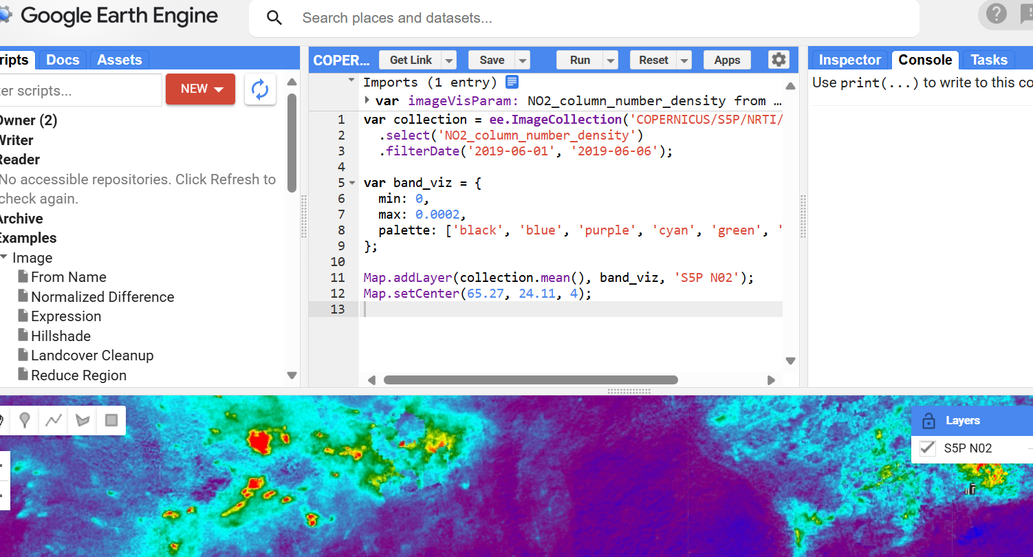
GOOGLE EARTH SNIPPET(DATASOURCE)

Slide 14

SHAPE FILE

Slide 15
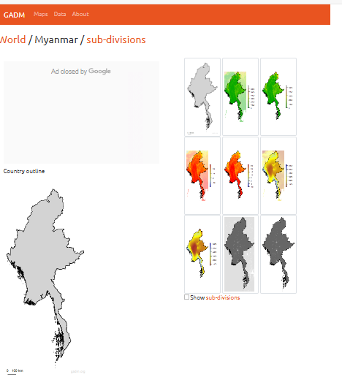

Slide 16
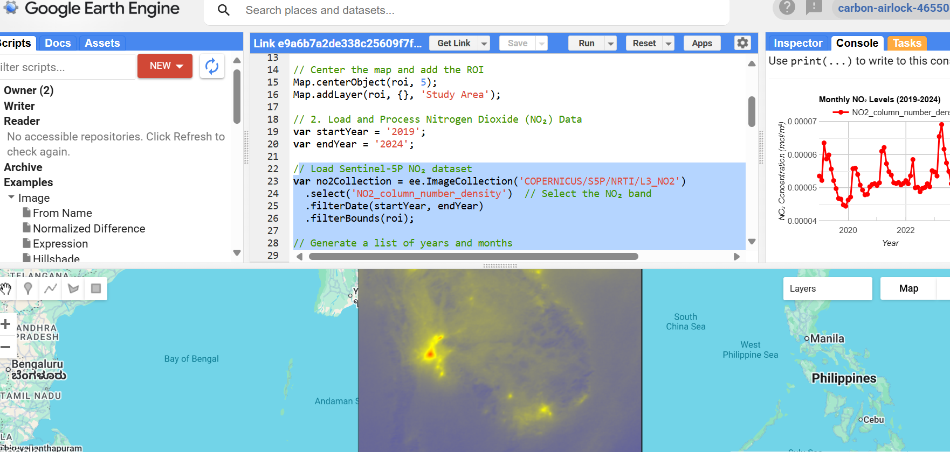
LOADING DATA AND CALUCLATING (YEAR)

Slide 17
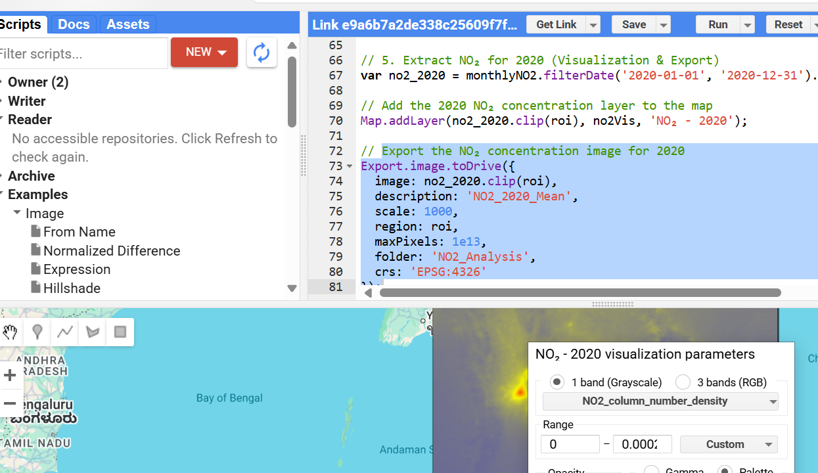
EXTRACTION NO2 CONCENTRATION

Slide 18
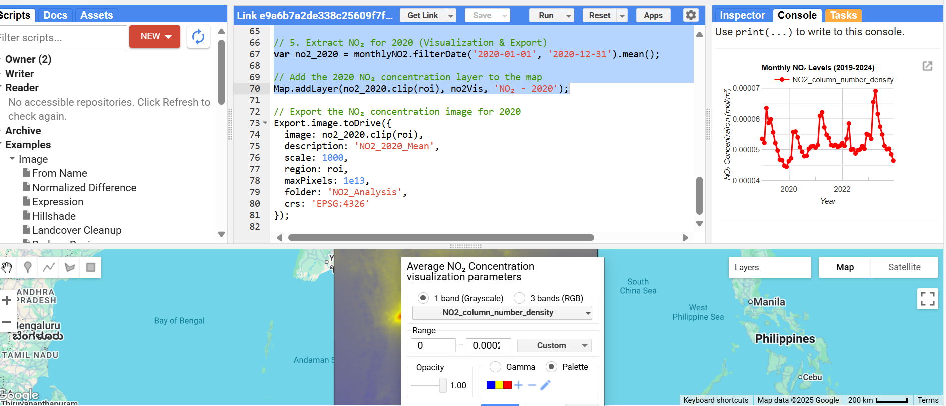
AVERAGE (MEAN ESTIMATION)

Slide 19
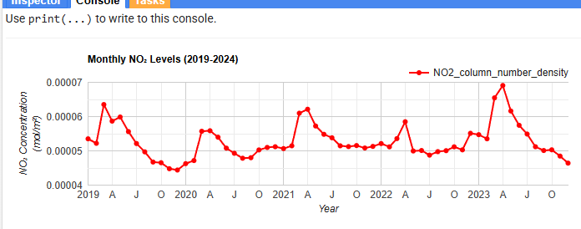
RESULTS

